Slide 1


Welcome to GitHub for Bioinformatics
Understand the basics of GitHub and its relevance in bioinformatics research.

Slide 2
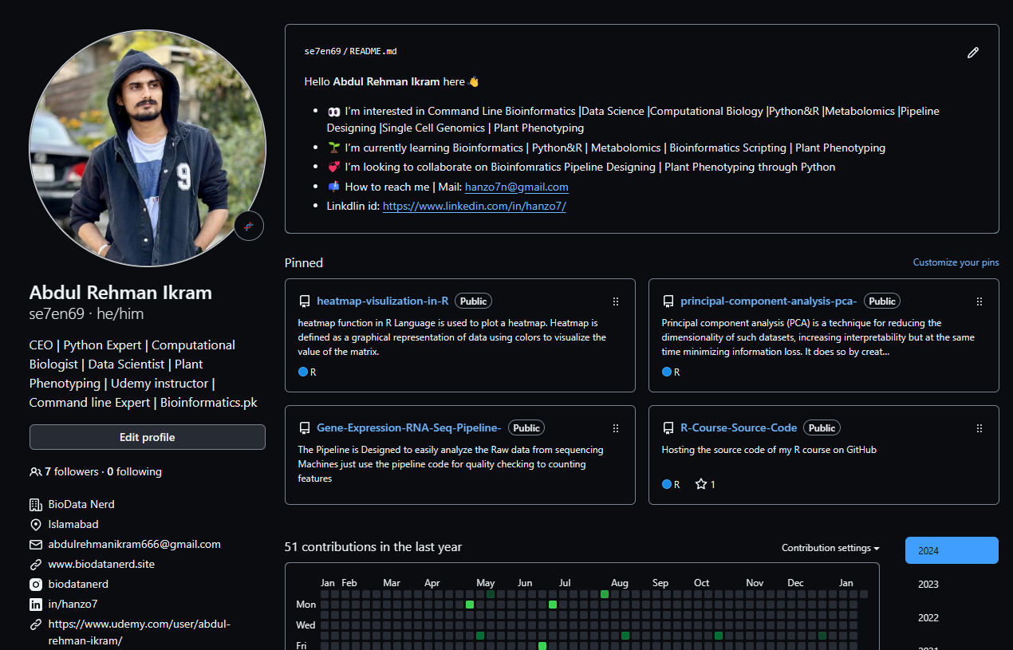
About Instructor
Abdul Rehman Ikram
CEO/Founder Biodatanerd.site/Article Assist's |Python&R |Command Line Bioinformatics |Data Scientist |Computational Biologist |Udemy instructor |Metabolomics |Pipeline Designing |Single Cell Genomics |Plant Phenotyping

Slide 3
Overview of GitHub
Version Control
Collaboration
Web-based Interface
Used for tracking changes and managing revisions of projects.
Facilitates teamwork by allowing multiple users to work on projects simultaneously.
Provides an easily accessible graphical interface for repositories.

Slide 4
Version Control
Version control is a system that records changes to a file or set of files over time so that you can recall specific versions later. It allows you to track modifications, revert to previous stages, and compare changes between versions. This is especially useful for software development, where multiple developers might be working on the same codebase or when you want to keep a history of changes made to a project.
One of the most popular version control systems is Git, which is widely used in software development. Git allows developers to work on projects simultaneously, merge changes from different sources, and maintain a complete history of all modifications. It also enables collaboration by providing mechanisms for resolving conflicts that may arise when different developers make changes to the same file.

Slide 5
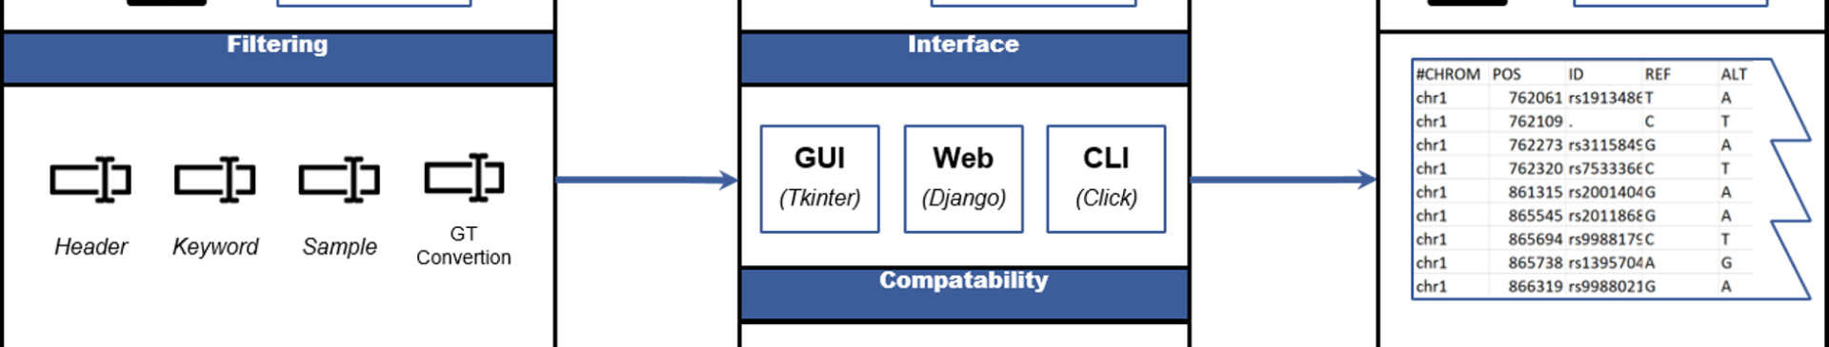
Importance in Bioinformatics
1
Version Control
2
Collaboration
3
Transparency
Enables precise tracking of changes in both code and data files.
Enables teamwork and sharing of resources for bioinformatics projects.
Provides public repositories for sharing and reproducibility of research.

Slide 6
Basic Concepts of GitHub
1
Repository
2
Commit
A collection of files and folders, akin to a project folder.
A saved change to a file or set of files, creating a new revision.
3
Branch
4
Pull Request
A parallel version of the repository, often used for experimental changes.
A request to merge changes into the main branch, enabling collaboration.

Slide 7
Collaboration Tools on GitHub
1
Issues
Track tasks, enhancements, and bugs, ensuring nothing is overlooked.
2
Pull Requests
Discuss and review code changes, suggesting improvements and updates.
3
Project Boards
Organize and prioritize work, keeping all tasks and timelines in one place.
4
Actions
Automate workflows, such as testing and deployment, for smoother collaboration.

Slide 8
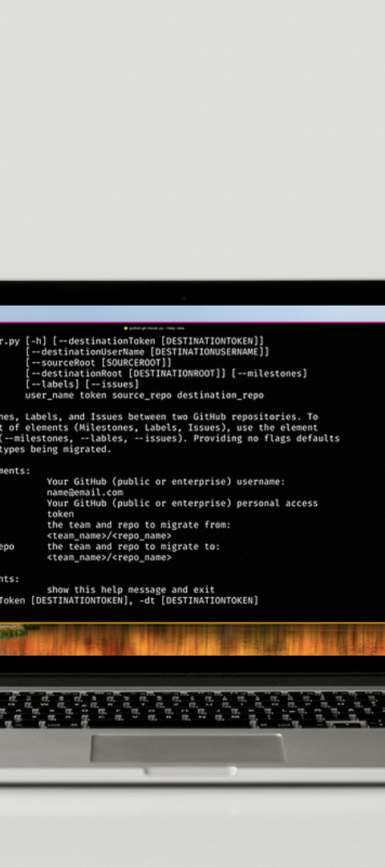
Enhancing Bioinformatics Projects
Organization
Efficiency
Provides a structured framework to manage projects efficiently.
Improves productivity and facilitates seamless coordination among team members.
Transparency
Enables the sharing of research, making it accessible for review and reproducibility.

Slide 9




Maximizing Project Workflow
Plan
Collaborate
Outline and structure the project tasks and timelines.
Work seamlessly with team members, sharing resources and insights.
Automate
Review
Implement actions to automate repetitive tasks, enhancing efficiency.
Consistently review and improve code and project elements for high-quality outcomes.

Slide 10
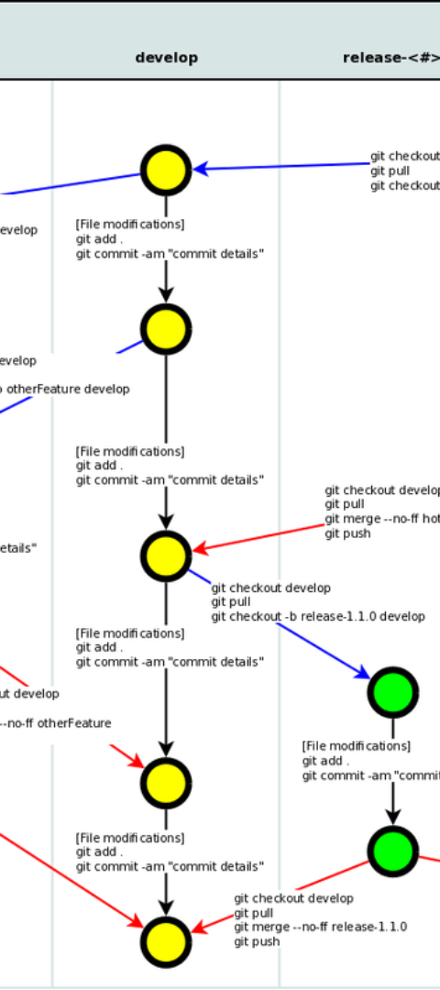
Best Practices for GitHub Usage
1
Consistent Commit Messages
2
Regular Branch Merging
Integrate code changes frequently to maintain a cohesive project structure.
Use clear and concise messages to document changes effectively.
3
Thorough Code Reviews
Encourage detailed reviews for quality improvement and knowledge sharing.

Slide 11
GitHub Security Measures
2FA
SSH Keys
Two-Factor Authentication
SSH Keys
Enhance security by adding an extra layer of account protection.
Securely connect and authenticate users and repositories.
Access Control
Data Encryption
Set precise controls to manage user permissions and repository access.
Ensure secure storage and transfer of sensitive project data.

Slide 12
Leveraging GitHub Insights
Analytics
Trends
Gain valuable data and insights into project performance and user engagement.
Track changes in project contributions and collaborative patterns for future improvements.

